Slide 1
Group 14
Alex Polley, Ryan Manthorp, Daniel Pokladek, Tom Mclaren

Slide 2
Logline/ Introduction
The history of earth is at risk when book mites that consume history invade a bookshop on the moon

Slide 3
Target Audience
Teenagers & Kids will find the historical theme interesting.
Young Adults and Teenagers will be interested in the historical and educational theme of sorting books chronologically.
Young Adults & Teenagers will like the puzzle genre of the game.
Teenagers and Young Adults are the majority of mobile players. Puzzle games go well with mobile games.
Notes:
Teenagers and Kids:
historical theme of sorting books and learning history ++
Educational theme can be appealing to students and kids
Young Adults & Teenagers:
Majority of mobile players ++
They will find the theme of history interesting
Puzzle games go well with mobile games, as they are easy to play on mobile platforms

Slide 4
Emotions
Monachopsis, the subtle but persistent feeling of being out of place
Achieved by having subtle hints that this bookshop is out of place when player makes progress to the next puzzle
Vellichor, the strange wistfulness of used bookshops
Achieved by showing vintage décor and artwork of bookshop. The bookshop backgrounds will change as player progresses through puzzles.

Slide 5
What does the player do?/ Mechanics
The player will be moving books with the mouse
Player will have to stack the books in such a way that there are no gaps in order to trigger the secret doors that lead to the most important books in history
The player will also shoot mites/ worms with lasers to protect the books

Slide 6
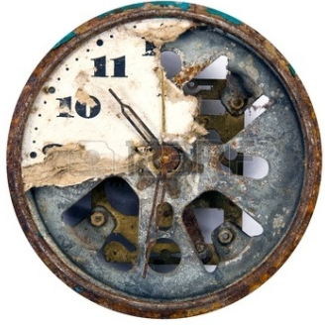
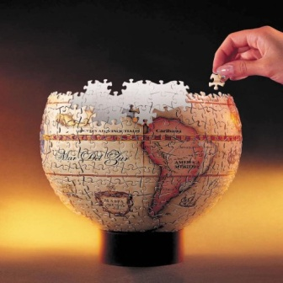
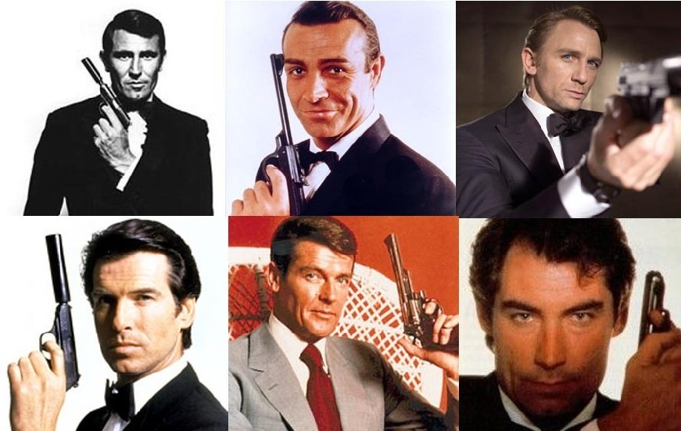
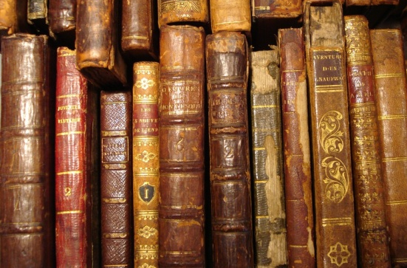
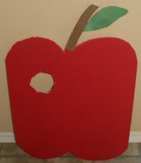
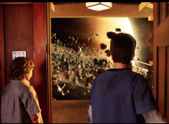
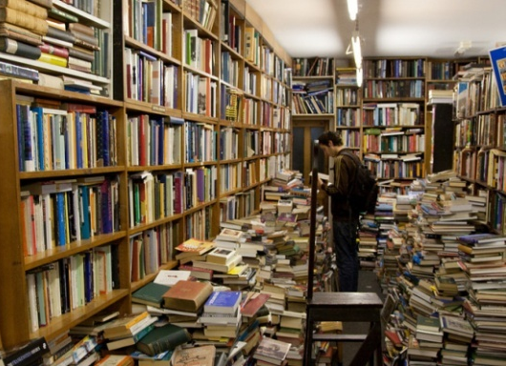
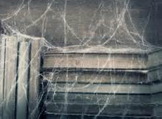
Moodboard
The burnt slow destruction of time and history
Missing countries of the world
Incorrect order
Rare & worn down books
Missing segment (eaten by worm)
Realisation you’re no longer on earth (Zathura Movie Scene)
Unorganized chaos (no order)
Dusty & ancient books

Slide 7
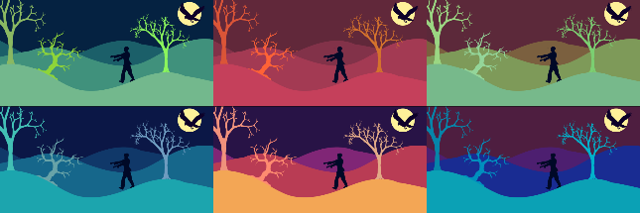

Art Style
The art style is still yet to be decided
The Font Style chosen includes a fading effect. Thus evokes the player feeling of vellichor, because the font has a used and worn down look.
As our backgrounds within the game change, when players progress through puzzles. Therefore our colour pallets will also represent that change.
The colour palettes used on each background will make the player feel out of place, within the game. Therefore producing the emotion of Monachopsis.

Slide 8
Project management
Emails sent
Alex: 7
Ryan: 5
Daniel: 2
Tom: 4
Overall: 18
Meetings
1 informal meeting, 30 mins
Hours logged
No hours logged yet, first sprint to be set today

